Slide 1







CYBER SECURITY INTERNSHIP AT
PHISHING ATTACKS
& CYBER AWARENESS
THINK BEFORE YOU CLICK. PROTECT THE HUMAN LAYER.
PRESENTED BY
DIXIT THUMMAR
STUD_ID : CA/DE1/2279

Slide 2








INTRODUCTION
WHY PHISHING AWARENESS MATTERS ?
Phishing is the #1 social-engineering threat — it targets humans, not systems.
Attackers exploit trust, curiosity, and urgency to trick users into mistakes.
KEY STATS :
$4.88M
68%
1M+
avg. breach cost
(IBM 2024)
Breaches involve human error (Verizon DBIR 2024)
Phishing attacks in
Q1 2025 (APWG)

Slide 3






GOAL OF THIS SESSION:
LEARN
IDENTIFY
PREVENT
RESPOND

Slide 4








WHAT IS PHISHING?
DEFINITION:
Phishing is when someone tricks you with fake messages or websites to steal your personal information or money.
CHANNELS:
Email, SMS, Social Media, Phone Calls
Attackers use psychological triggers like trust and urgency to make you click.
PILLARS OF PHISHING:
🤝 TRUST – LOOKS LEGITIMATE
⏰ URGENCY – ACT NOW PRESSURE
🏢 FAMILIARITY – KNOWN BRAND IMITATION

Slide 5



WHY HACKERS USE PHISHING ?
IT’S CHEAP, FAST, AND WORKS.
Phishing is the easiest way to access secure systems — through people.
KEY DRIVERS:
SCALABLE — THOUSANDS OF TARGETS VIA AUTOMATION
LOW COST, HIGH ROI — KITS UNDER ₹900
FACT: 94% OF MALWARE IS DELIVERED VIA EMAIL ATTACHMENTS.

Slide 6






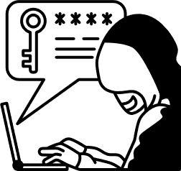

HOW PHISHING WORKS ?(KILL CHAIN)
1.RECON (RESEARCH):
LURE (TRAP):
DECEIVE (TRICK THE USER):
Attacker collects basic information about the target from social media, company websites, etc.
They send a fake email, message, or link to trick the person.
The victim is guided to a fake website or harmful link that looks real.
4.CAPTURE (STEAL INFO):
5. EXPLOIT (USE THE STOLEN DATA):
The attacker steals passwords, OTPs, or installs malware.
They take money, hack accounts, or sell the stolen data.
NOTE
MOST PEOPLE GET FOOLED IN THE DECEIVE STEP
— THAT’S WHERE ATTACKERS MAKE THINGS LOOK REAL.

Slide 7











TYPES OF PHISHING
EMAIL
SPEAR
WHALING
Fake emails trying to trick you.
A fake email made specially for you.
Tricks made for big people like CEOs.
SMISHING
VISHING
HTTPS TRAP
Fake or scam messages on SMS.
Scam phone calls pretending to be real people (bank, police, etc.)
A fake website that looks safe because it shows a lock sign.
QUISHING
PHARMING
ANGLER
Scanning a bad QR code that sends you to a fake website.
Your browser is secretly sent to a fake website even if you type the right address.
Fake help accounts on social media trick you.

Slide 8

EMAIL PHISHING: RED FLAGS
LEGIT EMAIL SIGNS:
FAKE EMAIL SIGNS:
1. Correct Email Address -
support@amazon.com
help@bankofindia.co.in
2. Normal, Calm Message -
“Your order has been shipped.”
“Please review your monthly statement.”
3. Makes Sense to You -
You actually ordered something
You requested a password reset
1. WRONG OR WEIRD ADDRESS.
- amaz0n-help@gmail.com
2. URGENT/SCARY TONE.
- “Your account will close in 30 mins!”
3. ASKS FOR PRIVATE INFO.
- “Send your OTP now.”
4. SPELLING MISTAKES.
- “Your account is terminated.”
5. UNEXPECTED ATTACHMENT
- Invoice.zip .
6. LINK GOES TO A FAKE SITE.
- fake-login123.com

Slide 9
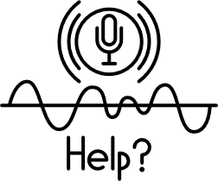


SMISHING & VISHING
SMISHING (SMS PHISHING) :
VISHING (VOICE PHISHING) :
WHAT IT IS:
WHAT IT IS:
Scammers send text messages to trick you.
Scammers call you on the phone.
COMMON LIES:
WHO THEY PRETEND TO BE:
Your bank account is blocked" or "You have a package waiting."
Bank staff, Tech Support, or Police.
THE TRAP:
THE TRAP:
They want you to click a link to steal your passwords.
They try to scare you into giving them money or details.
SIMPLE SAFETY RULES :
Don't Click : Ignore strange links in SMS.
Keep Secrets : Never tell anyone your OTP or Password.
Hang Up : If a call feels wrong, cut it. Call the bank yourself using the number on your card.

Slide 10


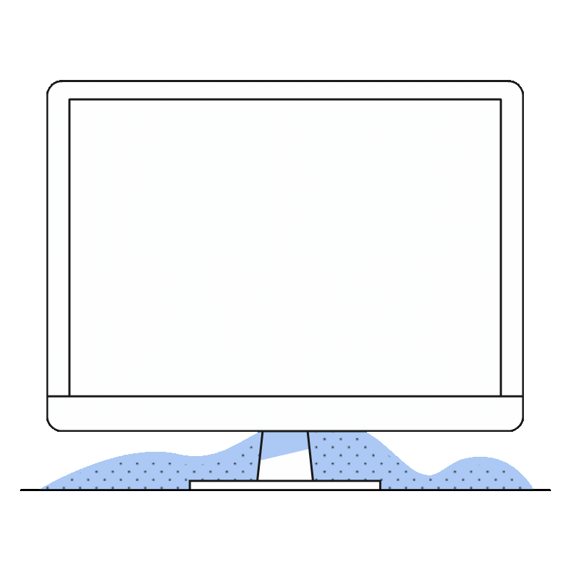

FAKE WEBSITES & HTTPS MYTHS
❌ FAKE WEBSITE | ✅ REAL WEBSITE
Spelled wrong (e.g., amaz0n.com, go0gle.net). | Spelled correctly (e.g., amazon.com).
Has a lock 🔒 but the website name is wrong. | Has a lock 🔒 AND the website name matches exactly.
Blurry images, bad grammar, or looks "messy." | Professional design, clear images, perfect grammar.
Creates Panic: "Login NOW or lose account!" | Calm: Provides information without rushing you.
Hidden info: No address or phone number. | Transparent: Easy to find "Contact Us" details.

Slide 11

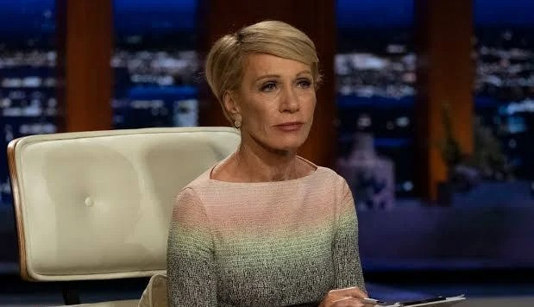


CASE STUDY: THE "SHARK TANK" SCAM
THE VICTIM :
Barbara Corcoran (Star of TV show Shark Tank).
THE SCAM :
Email Phishing using a fake name.
THE METHOD :
The bookkeeper received an email asking to wire $388,000 for a "real estate renovation."
The email looked like it came from Barbara’s assistant.
The Trick: The scammer changed one letter in the email address (Typo squatting).
- Real: assistant@barbaracorcoran.com
- Fake: assistant@barbaracorcorn.com (Missing the 'a' in Corcoran).
THE RESULT :
The money was sent immediately. It was lost.
LESSON LEARNED :
✅ Check the Spelling: Always read email addresses letter-by-letter.
✅ Double-Check Payments: If someone asks for money via email, call them on the phone to confirm.

Slide 12



HOW PHISHING TRICKS YOU
THE PSYCHOLOGY :
Hackers play with your emotions, not your logic — they make you react fast without thinking.
COMMON TRICKS :
HOW TO OUTSMART THEM:
👨‍💼 Authority : Pretend to be your boss or IT team
😨 Fear : “Your account will be blocked!”
⏰ Urgency : “Act now or lose access!”
Stop and read carefully
Verify the sender through a different channel (phone/chat)
Ask yourself → “Why do they want me to act so fast?”

Slide 13
WHY PHISHING IS DANGEROUS
PHISHING DAMAGES PEOPLE, COMPANIES, AND SOCIETY.
FOR YOU:
FOR COMPANIES:
WORLDWIDE:
💸 MONEY LOSS
🔐 IDENTITY THEFT
😞 STRESS
📉 AVERAGE LOSS
💸 $4.88 MILLION
🏢 REPUTATION HIT
OVER $16.6 BILLION LOST YEARLY TO CYBERCRIME
💡FACT :
ATTACKS FOUND WITHIN 200 DAYS SAVE ABOUT $1.2 MILLION ON AVERAGE.

Slide 14




PHISHING FACTS & WARNING SIGNS
2025 QUICK STATS:
68 % of breaches = human error
64 % of companies hit by fake business emails (BEC)
94 % of malware sent by email
1 million + phishing attacks in Q1 2025
RED FLAGS TO SPOT:
✅ Too-good-to-be-true offers
⚠️ Urgent or threatening tone
🔍 Misspelled domains or fake links
🖱️ Hover links to see the real site

Slide 15



STAY SAFE
PERSONAL & WORKPLACE
PERSONAL PROTECTION:
FOR ORGANIZATIONS:
Use a Password Manager
Turn on Two-Factor Authentication (MFA)
Keep your apps and system updated
Report suspicious emails to security team
Use Secure Email Gateway (SEG)
Enable SPF, DKIM, DMARC for domain security
Run simulated phishing tests for employees
Add a “Report Phishing” button in mail apps

Slide 16
IQ QUIZ
Q1: YOU RECEIVE AN EMAIL FROM “MICROSOFT SUPPORT” SAYING “YOUR ACCOUNT HAS BEEN COMPROMISED. CLICK HERE TO SECURE IT.”
🅐 CLICK THE LINK TO CHANGE YOUR PASSWORD
🅑 CHECK THE SENDER’S EMAIL AND GO DIRECTLY TO MICROSOFT’S OFFICIAL SITE ✅
Q2: YOU GET AN SMS FROM YOUR “BANK” SAYING “YOUR DEBIT CARD WILL BE BLOCKED. UPDATE YOUR KYC NOW!”
🅐 TAP THE LINK IN THE MESSAGE
🅑 IGNORE THE LINK AND CALL YOUR BANK USING THE OFFICIAL NUMBER ✅
Q3: YOU SEE AN ONLINE AD SAYING “CONGRATULATIONS! YOU’VE WON AN IPHONE 15. CLAIM NOW!”
🅐 CLICK IT AND FILL IN YOUR DETAILS
🅑 AVOID IT — IT’S A CLASSIC PHISHING LURE ✅
Q4: YOUR “HR DEPARTMENT” EMAILS A NEW FORM ASKING YOU TO ENTER YOUR LOGIN DETAILS TO VIEW YOUR SALARY SLIP.
🅐 LOG IN USING THE LINK INSIDE THE EMAIL
🅑 VERIFY WITH HR DIRECTLY BEFORE CLICKING ANY LINKS ✅
Q5: YOU GET A CALL FROM SOMEONE CLAIMING TO BE FROM “YOUR BANK’S FRAUD TEAM,” ASKING FOR YOUR OTP.
🅐 SHARE THE OTP TO CONFIRM YOUR IDENTITY
🅑 NEVER SHARE OTPS — NO BANK EVER ASKS FOR THEM ✅

Slide 17



CONCLUSION & KEY TAKEAWAYS
IF YOU FALL FOR IT:
REMEMBER:
Disconnect from the internet
Change passwords (on a safe device)
Inform IT or Security team
Run antivirus scan
Humans = weakest link and strongest defense
Always verify before you click
“Phishing is inevitable — damage is optional.”
Stay alert and protect the human layer.

Slide 18

THANK YOU
"SECURITY IS NOT A PRODUCT,
IT’S A PROCESS."
DIXIT THUMMAR
DIXITTHUMMAR5@GMAIL.COM
https://github.com/Dixithummar
www.linkedin.com/in/dixit-thummar-450784363

